Slide 1

Embrace the Graph Database
Powerful algorithms & more
Remington Campbell
Software Systems Engineer, Cisco
github.com/cisco-ie

Slide 2

Remington Campbell
Software Systems Engineer, Cisco
Remington is a software/systems engineer with a focus on outcome enablement through digitization and software technologies. He is an avid GitHub stargazer and member of Cisco’s Innovation Edge team.

Slide 3
Previously @ DevNet Create
github.com/cisco-ie/ez-dash

Slide 4
Dashboarding with Open-Source Monitoring Stacks
Made Easy
Karthik Kumaravel & Remington Campbell
Software System Engineers, Cisco
github.com/cisco-ie
Notes:
Rem

Slide 5
Today!
Databases!
Graph algorithms!
Time-series!
Visualization!
Programming!!
ArangoDB
InfluxDB
Python
D3.js / El Grapho
HTML5/CSS/JS
Special thanks to Docker

Slide 6
The Personal Anecdote
Graph databases are natural to think about
Dramatically simplified PoC development
Powerful algorithms out-of-box

Slide 7
Some concepts…

Slide 8
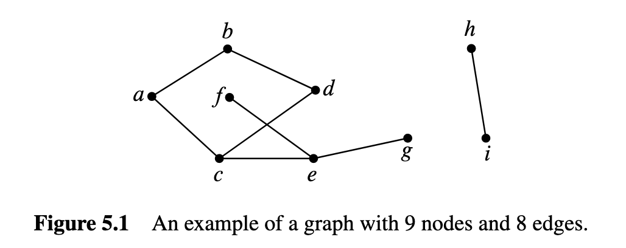
Graphs
“Informally, a graph is a bunch of dots and lines where the lines connect some pairs of dots. … The dots are called nodes (or vertices) and the lines are called edges.”
MIT OpenCourseWare

Slide 9
Graphs in Action
Facebook Social Graph
Google Knowledge Graph
LinkedIn Knowledge Graph & Activity Graph
Routing protocols (RIP, OSPF, …)
Effectively anything relating entities together!

Slide 10
Graph Algorithms
BFS, DFS, MST, … (oh my)
Many useful algorithms for graph data structures
Dijkstra’s algorithm is a classic

Slide 11
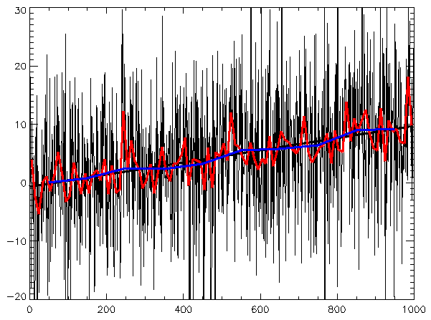
Time Series
Metric-focused
Collection of observations at discrete or continuous times.
Compression!
Prediction!
CC BY-SA 3.0, https://commons.wikimedia.org/w/index.php?curid=647831

Slide 12
Today’s Objective Simulate & powerfully visualize.

Slide 13
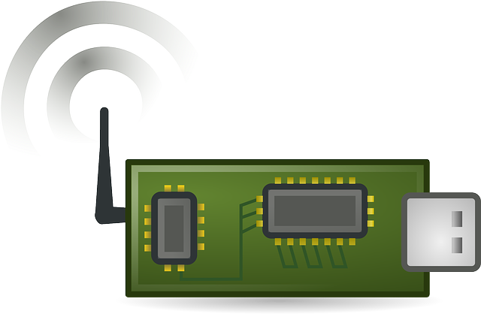
Wireless Sensor Networks
Naively, we can pretend that
this is how wireless sensor
networks work.
Assuming a mesh environment,
statistics like signal strength, energy, reliability, etc. are important for making decisions on when and how to send data.
Let’s simulate one. ☺
Warning: Some artistic freedoms taken.

Slide 14
How?
Python-based simulator
Python-based API
InfluxDB time-series database
ArangoDB graph database
Grafana time-series visualization
Graph visualization with D3.js and El Grapho

Slide 15
Technologies

Slide 16






Architecture
HTTP
We simulate a wireless sensor network topology.
We periodically publish telemetry over MQTT.
Our API ensures the data is in InfluxDB and ArangoDB.
We visualize our graph with El Grapho.
We can explore data with Grafana.
API
MQTT
Simulator
All in Docker

Slide 17
Simulator & API - Python
Simulator simulates sensor nodes.
API provides API for interaction with databases.
Developed with Python
Simple to run & modify.
Boilerplate has been developed, we’re going to add value!

Slide 18

Time Series Database Monitoring & Analytics
Time Series Platform (TICK)
Telegraf – Collector
InfluxDB – Time Series Database
Chronograf – Visualization/Management
Kapacitor – Streaming Data Processing

Slide 19
”The open platform for analytics and monitoring”
Visualization/alerting capability across multiple data sources.
Great plugin community and can tie data sources together!
Notes:
Karthik

Slide 20
Interesting & flexible database
Key/value, document & graph models
AQL – ArangoDB Query Language
We will be highlighting the graph capabilities.

Slide 21
MQTT is a low-power IoT pub-sub protocol
Publish data to a “topic”
Subscribe to topic to receive the data!
Mosquitto is an open-source broker
MQTT used in AWS IoT, etc.

Slide 22
Graph Visualization
D3.js is flexible and popular
El Grapho is performant and very simple
Many extremely powerful libraries in this space!

Slide 23
Let’s get started!

Slide 24
https://github.com/cisco-ie/embrace-graph-database
If you have git installed…
git clone https://github.com/cisco-ie/embrace-graph-database
Otherwise…
https://github.com/cisco-ie/embrace-graph-database/archive/master.zip

Slide 25
# Download ez-dash
git clone https://github.com/cisco-ie/embrace-graph-database
cd embrace-graph-database
# If you have never run Docker Compose before...
./setup.sh
.\setup.bat # Windows
# Start the stack!
./start.sh
.\start.bat # Windows

Slide 26
Bonus Topics

